Slide 1
Unit 3 Knowledge Organiser Health, safety and security in health and social care.
LO1:
Potential hazards
Potential impacts of hazards for individuals who require care or support, employees and employers
Harm and abuse.

Slide 2
LO1 Potential hazards in health, social care and child care environments.
Hazard: Something that could potentially harm someone or could cause and adverse effect on health.
Manual handling: using the correct procedure when physically moving any load by lifting, putting down, pushing or pulling
Type of hazard | Examples in care environments
Environmental | Work or damaged equipment, furniture and flowing can cause slip and trip hazards resulting in sprains, bruising, fractures or being knocked unconscious.
Biological | Medical or other waste products not disposed of following correct procedures and poor levels of hygiene can result in the spread of infection and disease.
Chemical | Medicines – incorrect doses being administered, wrong medication, unauthorized access to medication can have serious health consequences. Cleaning materials – stored or used incorrectly can cause serious physical harm.
Psychological | Fatigue and stress – due to long working hours, coping with challenging behavior, violence, abuse from service users, bullying in the workplace.
Physical | Excessive loud noise at work, i.e. continuous use of a loud hoover can cause ringing in the ears, deafness or other ear complaints. Radiation from electromagnetic rays like x-rays and gamma rays – X-rays, used in medical environments for scanning internal organs and diagnosing broken bones. Gamm rays are used in the treatment of cancers and sterilising medical equipment.
Musculoskeletal | Manual handling – equipment, patients, residents can cause muscle injuries if not carried out correctly following procedures. Display Screen Equipment (DSE) -incorrect posture or badly placed screen can cause muscular aches and pains and also repetitive strain injuries (RSI).
Working conditions | Temperature – to hot or too cold can cause dehydration and make conditions such as asthma worse. Hearing can be damaged with long-term exposure to noise levels that are too high. Stress and fatigue can be caused by travelling long distances, being away from home and sitting in traffic for periods of time.
Working practices | Excessive hours result in accidents and mistakes as a result of lack of concentration and tiredness. Lack of supervision for new staff or those taking on new tasks. Training essential to avoid accidents and errors. i.e. using a hoist to incorrectly could lead to injury.
Lack of security systems | Door locks, alarm systems and monitoring of all visitors are all measures to prevent unauthorized access by strangers who may pose a threat of harm to individuals in care environments. Security may not be in place or faulty due to poor maintenance.

Slide 3
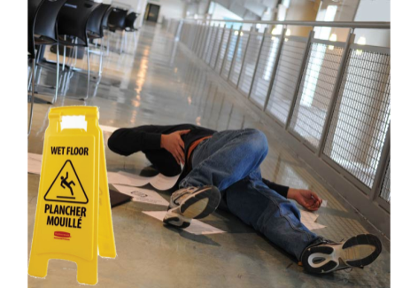
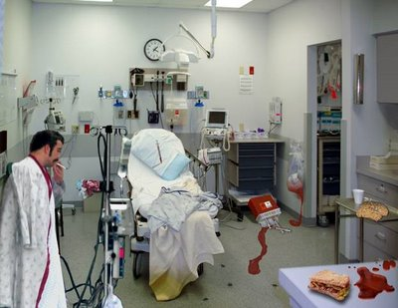
Examples of hazardous activities in care settings:
Potential impacts of hazards for individuals who require care or support, employees and employers.
Assisting an individual out of a wheelchair.
Cleaning – cleaning chemicals materials, noisy hoovers.
Dressing wounds, changing nappies and contact with bodily fluids.
Exposure to infections.
Helping a person out of bed.
Helping a person out of the bath.
Lifting heavy equipment.
Picking someone up from the floor.
RSI from using display screen equipment.
Using a hoist or bed board to transfer individuals.
Violent or abusive service users.
Hazards can impact on everyone who uses a care setting. For each listed below, outline how hazards can impact on them.
Employees:
Individuals who work in a care setting, such as nurses in a hospital or teaching in a primary school. Staff in care settings may develop mental health illnesses such as depression or stress and physical effects such as high blood pressure if their workload is excessive. They may sustain back injuries if they do not receive the correct or adequate training got things such as manual handling.
The Employer:
A manager or owner of a care setting who employs staff. Examples include a Headteacher of a school or owner of a residential home. Employers could face serious consequences, such as being taken to court, being fined or closed down. For example if an individual is seriously injured due to a hoist not being worn out or poorly maintained. This could also result in a care setting developing a poor reputation to failing and inspection.
Individuals who require care or support:
Service users, the people who go to a service, such as; hospital patients, people attending a day centre etc. Individuals who require care or support may not receive adequate levels of care if staff do not have enough time to do their job properly sue to staff shortages or a lack of training. Staff who do not maintain high standards of hygiene can cause infection to spread amongst individuals – like MRSA. An individual requiring care or support might suffer financial loss if their belongings are stolen or damaged while using a service.
Examples of practical hazards:
Broken furniture
Broken toys
rugs
Clutter
Examples of practical hazards
stairs
Wet floors
Extension cords
Objects on the floor
Uneven flooring
Poor lighting

Slide 4
MRSA: serious bacterial infection that can spread quickly in settings like a hospital where people are more vulnerable due to open wounds and weakened immune systems.
Potential impacts of hazards in care settings
Impacts of hazards
Injury or harm
Illness
Poor standards of care
Financial loss
Illness
Impacts of hazards can also result in illness:
Eye strain
Food poisoning – diarrhoea and sickness
Headaches
High blood pressure
Infections
Mental health – anxiety, depression, disempowerment, burnout
MRSA
Being unable to work, leading to staff absence.
Injury or harm:
Poor standards of care
Back injuries – musculoskeletal damage, slipped disc, injured muscle.
Chemical burns
Cuts and bruises
Deafness
Fractures – arm, leg, rib, ankle, collarbone
Injury from intruders – terrorists or burglars.
Radiation.
Poor standards of care can be caused by employees who:
Feel tired or exhausted
Forget to give medication
Forget to provide fluids or food
Lack concentration
Lack enough tie to do their job properly.
The impacts of poor standards of care on individuals who need care or support are:
Bed sores and pressure ulcers
Bruising due to poor handling
Dehydration
Health deteriorates / illness gets worse
malnutrition
Financial loss
Loss of earnings due to time off work
Loss of job
Compensation being received/pursued
Theft of personal money or belongings.

Slide 5
Harm and Abuse
Cross contamination – when bacteria spread on to food from another source like; hands, work surfaces, kitchen equipment or between cooked and raw food.
CQC –The Care Quality Commission, a government organization that inspects and regulates health and social care provision.
All individuals in care environments can be susceptible to the risk of harm and abuse to they may be perpetrators of harm and abuse themselves.
Intentional abuse:
This is deliberate abuse, examples of this are; theft, verbal abuse, physical abuse, sexual abuse and financial abuse.
Unintentional Abuse:
Can be caused by carelessness, lack of training to do things correctly or as a result of neglect. For example; poor care of a patient leading to pressure sores, a nursing home resident suffering from dehydration as fluid intakes are not being monitored. A catering assistant in a primary school forgetting to wash their hands before preparing food – could cause cross contamination, leading to an outbreak of food poisoning.
Possible effects for abusers of abuse in care environments.
Possible effects
Having to attend training or be re-trained.
Disciplinary action.
Imprisonment
School placed in special measures by Ofsted.
Suspension.
Dismissal.
Sued for negligence – financial loss.
Criminal prosecution,
Loss of professional status – nurse, doctor, social worker, teacher.
Care or health environment fined or closed down.
Possible effects of abuse in care environments for individuals who have experienced abuse.
Anger Anxiety Death Denial Depression Disempowerment Embarrassment Fear Feeling betrayed Financial hardship | Illness, deterioration of health Injury Lack of sleep Loss of confidence Loss of trust Low self-esteem Self-blame Self-harm Suicidal feelings Becoming withdrawn

Slide 6
Types of Settings:
Health Care Environments:
Clinic
Health Centre
Dental practice
Drop-in surgery
GP surgery
Hospital
Medical centre
Nursing home
Optician
Pharmacy
Care Environments:
Community centre
Day centre
Lunch club
Individual’s own home
Residential care home
Retirement home
Social services department
Support group
Child Care Environments:
Breakfast club
Child minder
Children’s centre
Crèche
Foster home
Kindergarten
Nursery
Playgroup
Pre-school
Primary school
Transport:
Ambulance
Care
Boat
Caravan
Coach
Ferry
Minibus
Taxi
Train
Public Environments:
Cinemas
Parks
Leisure centres
Religious groups i.e. Sunday school
Theme park
Theatre
Supermarkets
Riding stables
Café or restaurants
Shopping centres
Recreation ground
Sport clubs, i.e. Tigers, LCFC.
Exam Tips:
Read questions carefully to make sure you are answering about the right setting.
Read questions carefully to make sure that you are answering the question about the right focus, i.e. employee, employer to a service user.
Make sure you can identify different types of abuse and the effects on those being abused.
Be able to explain possible consequences for the abuser. (if it relates to the scenario you gain more marks)
Revision Activities:
Create match cards with examples of hazards and settings.
Create cue cards to learn examples of hazards.
On A3 paper use the diagram on page 2 of the KO ‘Potential impacts of hazards in care settings’ and extend each of the impacts by adding examples. For example; injuries of other effects for employers, employees or service users.
Google an image of a nursery playroom and identify hazards that could be found in it.
Try answering these:
Write a definition of hazard.
Identify two hazards that may be found in a hospital ward.
Explain the potential hazards for a hospital receptionist spending most of her working day using a computer.
Identify the four main impacts of hazards.
Describe the potential musculoskeletal hazards and their impacts on a health care assistant on a busy geriatric ward.
Explain the difference between intentional and unintentional abuse
What the five types of settings? Now give two examples for each setting.

Slide 7
Unit 3 Knowledge Organiser Health, safety and security in health and social care. LO2: How legislation, policies and procedures promote health, safety and security in health, social care and child care environments.

Slide 8
Legislation:
Legislation: a collection of laws passed by Parliament. It is upheld through the courts, which may prosecute individuals or an organisation if they break it.
Risk: likelihood that someone or something could be harmed.
PPE: Personal Protective Equipment provided by the employer; for example clothing and protective equipment to make sure that an individual is safe in their workplace and carrying out tasks.
Health and Safety at Work Act 1974
The Health and Safety at Work Act (HASAWA) established the Health and Safety Executive (HSE) as the regulator for health and safety in the work place. The purpose of the HSE as regulators is to monitor health and safety in the work place by carrying out spot checks and carrying out investigations if an accident happens. The legislation is enforced by the HSE by issuing improvement notices, fining settings or taking a setting to court. They also offer advice and guidance about how to minimise risks in a work place.
HASAWA -Employee responsibilities
Key Aspects | HASAWA states employers have the following responsibilities….
The working environment must not put anyone at risk. | Carry out risk assessments. Provide PPE. Have procedures in place to prevent accidents. Monitor staff practice. Ensure fire alarms, extinguishers and exits are accessible and working.
The equipment provided must be safe and in good working order. | Provide fit for purpose equipment in good working order. Safety check equipment regularly. Regular maintenance and service of equipment. Electrical equipment and appliances are PAT tested.
Employers must provide adequate health and safety training for staff. | Provide health and safety training for all staff – regularly updated. Staff trained to use specialist equipment. Regular fire evacuation practices. Provide adequate first aid.
A written health and safety policy should be provided. | Health and safety policy written in line with legal requirements. Ensure staff are aware of and have access to the policy. Display the Health and Safety Law poster.
Protective equipment must be available if needed to all employees and free of charge. | Maintain adequate supply of PPE. Staff are not charged for PPE. Ensure staff wear PPE provided.
Employees must ensure that they:
Cooperate with their employer by following health and safety regulations in the workplace.
Any hazards must be reported to the employer.
Provided protective clothing must be worn.
Do not misuse or tamper with equipment provided, that meets health and safety regulations. i.e. fire extinguisher.
Participate in any health and safety training provided.
Take care of themselves and others in the work place.

Slide 9
Management of Health and Safety at Work Regulations 1999
Food Safety Legislation
The key aspects of The Food Safety Act 1990 and how it impacts on care settings:
These regulations were introduced to reinforce and support HASAWA.
Regulations put duties on the employers and employees, with additional specific detail in relation to the safe management of health and safety.
Key aspects | Impact on care settings
Covers safe preparation, storage and service of food. ‘Food businesses’ must be registered, this includes; canteens, clubs and care homes. Environmental Health Officers (EHO) can: Seize food thought to be unfit for human consumption. Serve an improvement notice. Close a premises causing a risk to health. CQC requires that care services ensure that food and drink is handled, stored, prepared and delivered in a wat that meets the requirements of the Act. | Employers must maintain high standards of personal hygiene. Employees who prepare and serve food should be provided with training in food safety. Food should be stored correctly. Meals should be prepared, cooked and served safely and hygienically. Food provided must be safe to eat. Records must be kept of where food is from so it is traceable.
Key aspect | Employers must ensure
Specific detail added regarding HASAWA and the safe management of health and safety. | Risk assessments are carried out and any control measures needed are implemented. Competent individuals are appointed to manage health and safety and security – to deal with any emergencies that might happen. Information, training and supervision are provided so that work activities can be carried out safely.
Key aspects – Food Safety(General Food Hygiene) Regulations 1992 | Impact on care settings
Requires food safety hazards are identified. Setting should know the critical steps for food safety in their setting. Safety controls must be in place, maintained, and reviewed. Food handlers must wear suitable clean and appropriate PPE. Food handlers must be supervised and/or trained in food hygiene to an appropriate level. The preparation and cooking environment must be kept clean an din good condition. Adequate arrangements for storage and disposal of waste. | Use of Hazard Analysis and Critical Control Points (HACCP) to identify food safety hazards; packaging, work surfaces, food processing equipment, cookware and personal hygiene. Food safety controls and procedures must be in place and reviewed regularly. Food preparation/serving areas must be well maintained. Employers must provide appropriate personal hygiene facilities. Employers must provide clean, PPE, hairnets, hats, disposable gloves and aprons.
Risk assessment: the process of evaluating the likelihood of a hazard actually causing harm.
Control measures: actions that can be taken to reduce the risks posed by a hazard or to completely remove the hazard.

Slide 10
Food Standards Agency – CCP checklist for residential care homes.
Exam Tips:
Exam questions are often set in the context of a certain care setting – read the questions carefully and make sure you are answering about the right environment and whether the question is about the service user, employee or employer.
Don’t get your hazards mixed up. For example slipping on vomit is an environmental hazard, however food being covered with vomit is a biological hazard.
For LO1 questions – read questions carefully and make sure that in a scenario question, you can identify different types of abuse and the effect on the individuals being abused.
You must be able to explain the consequences for the abused and to gain the highest marks you have to relate the answer to the scenario in the question and not generalise.
You may be asked to identify key aspects of the Food Safety Act. The table on the left will assist with questions like – state three food safety requirements of a care home.
Read the Basic Food Hygiene Fact Sheet – www.food.gov.uk/business-industry/sfbb
Always be clear about whether you are writing about an employee, employer or a service user.
Don’t forget – avoiding the need to manual handle is the safest of all options as it completely reduces the risk of injury!
Safety Point | Why? | How do you do this?
Handwashing: Anyone who works with food should wash their hands before handling it. People with care duties should also wash their hands after: toileting, emptying bed pans, using medical equipment, touching dirty linen or clothing and handling pets or their feeding bowls. | Harmful bacteria can spread very easily from people’s hands to food, equipment and work surfaces. Handwashing is one of the best ways to prevent these bacteria spreading. | How do you make sure staff wash their hands at these times?
Food storage and preparation: Do not use foods past its ‘use by’ date and fridges are clean and operating below 5°C Storage instructions on food labels followed. Use open food within to days unless it states otherwise. Keep foods that are ready to eat chilled. | Older people may be more likely to suffer from food poisoning. These checks will help protect residents rom bacteria that could cause illness. – www.gov.uk/science/microbiology/listeria for more info if you want it. | Are staff trained to make the checks? Yes /No
Accidents: Make sure areas cleaned after an accident such as vomiting or diarrhoea are disinfected thoroughly. Wear suitable clothing/PPE i.e. disposable apron and hands are washed thoroughly. | Prevents harmful bacteria rom spreading to food from hands or uniforms. | How do you do this?
Meals: Care staff helping serve meals should wash their hands thoroughly and put on a clean disposable apron before serving or feeding residents. Visitors should be made to wash their hands if helping to feed residents. Visitors should not be allowed in the kitchen. | Helps prevent harmful bacteria spreading to food from our hands and or clothing (uniforms) | Are care staff trained to wash their hands and wear aprons before serving food. Yes / No What type of apron do care staff wear when helping with meals?

Slide 11
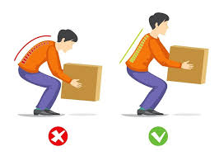
Manual Handling Operations Regulations 1992
Guidance for safe lifting
In health and social care environments, manual handling for care providers is a big thing. There are a number of situations where individuals requiring care or support (especially those with mobility issues), will need to be assisted safely to move and transfer from one place to another. For example, from a bed to a chair. Injuries can happen easily if methods used are not carried out correctly. Manual handling legislation requires the risk of injury to be reduced as far as possible.
Stand with feet apart
Bend the knees
Keep back straight
Lean slightly forward to get a grip of the item
Lift smoothly.
Manual Handling Operations Regulations 1992
(Amended 2002)
What should manual handling training include?
Key aspects | Impact on care setting
Avoid the need for manual handling as far as possible. Assess the injury risk for any manual handling that is unavoidable. Take action to reduce the risk of injury as far as possible. Employers mush provide information, training and supervision about safe manual handling. | Training must be provided for anyone who needs to carry out manual handling as part of their job role. Any manual handling activities must be risk assessed. Employees must not operate manual handling equipment unless they have been trained to do so. Reduced risk of injury. Reduced need for staff to undertake manual handling unless essential. Lifts should be planned and practiced before doing it for real.
Information about risk factors and how/why injuries can happen.
Techniques for manual handling safely for tasks in relation to an individuals place of work.
How to operate mechanical lifting aids, such as; hoists in a care home.
Practical work to allow the trainer to identify any potential errors and provide advice and correct what the trainee is not doing safely.
Revision idea:
Create a table with the headings as per the example below. For each care setting write a list of situations where manual handling may be required. You will then be able to used these as examples in an exam answer.
Health Care | Social Care | Child Care

Slide 12
Reporting of Dangerous Injuries, Diseases and Dangerous Occurrences Regulations 2013
Dermatitis – inflammation of the skin, can be sue to contact with an irritant or as a result of an allergic reaction. Symptoms include; itching, redness and in some cases blistering.
Statutory duty – an obligation required by law – something that has to be done.
This legislation is often known as RIDDOR, it is a legal requirement and requires employers to keep written records of and to report the following incidents to the Health and Safety Executive (HSE).
Work related accidents that cause death.
Work related accidents that cause serious injury, such as; loss of sight, serous burns, crush injuries- causing organ damage, hypothermia or heat induced illness.
Diagnosed cases of specific types of work related diseases, e.g. carpal tunnel syndrome, tendonitis, asbestosis, occupational dermatitis, occupations cancer, occupational asthma, exposure to biological agents.
Incidents that have a potential to cause harm – collapse of equipment, chemical spills and leaks, overflowing drains, gas leaks.
Records of the following must be kept:
Any accident, occupational disease or dangerous occurrence that requires reporting under RIDDOR.
Any other occupational accident causing injuries that result in a worker being away from work for or incapacitated for more than seven working days.
An accident book should be used for any accident (even if not reportable). The following information must be recorded:
Date, time and place of the event.
Details of those involved.
Summary of what has happened.
Details of injury/illness that resulted.
Keeping records enables employers to:
Collect information to help manage health and safety in their work place safely.
Information can be used to aid risk assessment.
Solutions to potential risks can be developed.
Prevention of injuries and ill-health.
Help control accidental loss or fines costs.
Public Health England (PHE) aims to detect possible outbreaks of disease and epidemics as quickly as possible. The ‘notification of infections diseases’ is the term used to refer to the ‘statutory duty’ to report notifiable diseases under the the Health Protection (Notification) Regulations 2010.
Diseases and illnesses that are reportable are:
Anthrax
Food poisoning
Hepatitis
Legionella / Legionnaire’s disease
Malaria
Measles
Meningitis
Salmonella
Tetanus
Tuberculosis (TB)
Typhoid
Typhus
Exam tip:
Learn the key aspects of RIDDOR so you can use the correct terminology when answering exam questions.
Make sure you use the correct terminology in questions about the Data Protection Act – learn the eight principles!

Slide 13
The Data Protection Act 1998
Civil Contingencies Act 2004
The Civil Contingencies Act (CCA) 2004 establishes a clear set of roles and responsibilities for individuals involved in emergency preparation and response at a local level. It requires that organisations in the health system, including; emergency services, local authorities and other NHS bodies are prepared for adverse events and incidents.
There are a number of emergency situations that may affect organisations and its ability to maintain patients’, residents’ or service users’ safety. For example an emergency may result in a health care setting needing shelter for its staff and patients in places of better safety or activating a full site evacuation.
Incidents and events might include:
An explosion of a suspect package
Extreme weather conditions
Fire
Flooding
Hazardous materials (hazmat) release – chemical, biological, radiation or nuclear.
Major transport incident
Outbreak of an infectious disease
Pandemic influenza
Power or utility failure
Terrorist event
Care environments handle data al of the time in the form of; patient records, test results, care plans, staff employment records, emails, phone calls are just some examples of this.
The eight principles of the Data Protection Act (DPA) aim to ensure that the data is only used as it should be and share with only authorised individuals who need to know and that it is kept safe and secure.
The eight principles of the Act state that data should be:
Processed fairly and lawfully
Used only for the purposed for which it was intended
Adequate and relevant but not excessive
Kept no longer than is necessary
Processed in line with eh rights of the individual.
Secured
Not transferred to other countries outside of the EU
Revision idea:
Try to think of an example for each of the eight DPA principles and what a GP surgery, Care home and Nursery do to implement the Data Protection Act.
The CCA requires NHS organisations and providers of NHS-funded care, fire, police services and local authorities to show that they can deal with such incidents. They have to provide plans for their response to a possible major incident and the Act requires organisations to carry out risk assessments and work together to plan their response to both local and national emergencies.
Examples:
Major incident plans
Plans for management of mass casualties
Shelter and evacuation planning
Fire, police or health service response plans
Lockdown or controlled-access plan
Pandemic – When an outbreak of an infectious disease spreads over a wide geographic area, e.g. a whole country. It affects a very high proportion of the population.

Slide 14
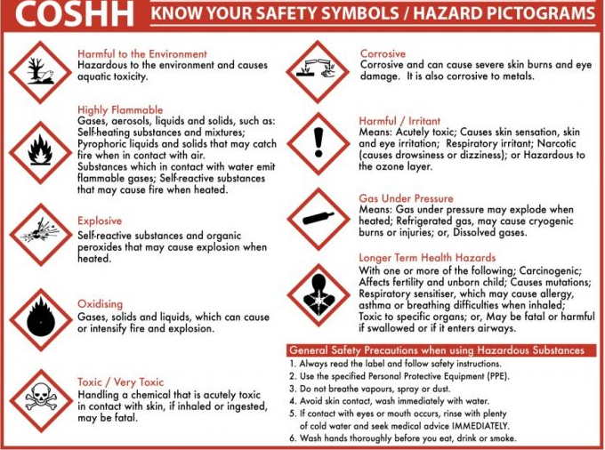
Control of Substances Hazardous to Health 2002
This legislation is also known as COSHH. There are lots of hazardous substances within care environments. For example; blood, urine, medication and cleaning materials. There is also hazardous waste like soiled bedding and used dressings in some care environments.
COSHH 2002 regulations require employers to either prevent or reduce their workers’ exposure to substances that a re hazardous to their health. They have to protect both staff and service users from harm by making sure that potentially dangerous substances are safely stored or disposed of and that staff are properly trained to carry out the tasks.
What does COSHH cover?
Storage, labelling and disposal of hazardous substances
Each work place must have a COSHH file which lists all of the hazardous substances within that setting
COSHH files must be kept up to date
Medication and chemicals must be kept in their original containers
Substances must be stored in a safe and secure place (i.e. locked cupboard)
Containers must have appropriate safety lids or caps (i.e. push down to turn)
What should be in the COSHH file?
Hazardous substances identified and named
Storage locations of hazardous substances
Identify what the labels on hazardous substance containers mean
Description of the effects of the hazardous substances
Must state the maximum time it is safe to be exposed to the hazardous substance
Description of action to be taken to deal with an emergency involved the hazardous substance.
Exam Tip:
Be able to list what should be in a COSHH file!
Know examples of hazardous substances in health (hospital ward) and social care (residential home) and child care (nursery) environments.

Slide 15
Safeguarding
Safeguarding – the measures that are taken to protect people’s health, wellbeing and rights, enabling them to be kept safe from harm, abuse and neglect.
Barred List – list of individuals on record as unsuitable for working with children and vulnerable adults
In health, social care and child care environment, practitioners must all be aware of the need for safeguarding.
The need for safeguarding:
There are some individuals that are more at risk of abuse, maltreatment or neglect than others, i.e. they are more vulnerable, this includes individuals with;
a learning difficulty
a physical disability
a sensory impairment (blindness or deafness)
lack of mental capacity (comatose or dementia)
looked after children (children in care)
These individuals might not want to, or be able to, report abuse or poor care for a number of different reasons. For example; they are dependent on carers and feel their treatment might get worse if they upset them. They might not understand their rights or even know they are being abused or poorly treated. If trey have a sensory impairment, they may not be able to see or hear who is mistreating them. Service users in care environments may not have anyone they trust to talk to. All staff in health and social care or child care environments have a duty of care to report any concerns.
Common safeguarding issues in adult care are:
Incorrect administration of medication, i.e. wrong dose, late or inappropriate (e.g. sedatives)
Pressure sores – those frail or reduced mobility are at risk on their pressure points and if untreated can become deep and infected – individuals like this should be repositioned regularly
Falls – individuals not risk assessed for risk of falls and / or walking aids not provided
Rough treatment – shouted at, rushed, ignored, man-handled
Malnourished – appropriate food not provided for religions, those who cannot chew or swallow properly or dietary needs
Isolation – lack of social inclusion, no stimulation, activities or opportunities to interact with others.
Institutionalised care – routines , systems and regimes of an institution result in poor care or inadequate standards of care and poor practice – i.e. people being forced to get up or go to bed at a certain time or being forced to eat
Physical abuse – could be between staff and residents or between residents
Financial abuse – staff inappropriately accepting gifts or theft of personal money or possessions.
Safeguarding children involves:
Protecting children from maltreatment = physical, psychological and emotional abuse
Preventing impairment of children’s health and development = education and physical health and well being
Ensuring children grow up in a stable home with provision of safe and effective care – removal from neglect or unstable/chaotic family life
Taking action to enable all children to have the best outcomes – providing support for families, fostering or adoption.
Disclosure and Barring Service (DBS):
DBS checks are a requirement for anyone aged 16 and over for roles volunteering or working with children or vulnerable adults, including those applying to foster or adopt. It ensures people are sage to work or volunteer with children and vulnerable adults.
There are three types of checks:
Standard – checks for criminal convictions, cautions, reprimands and final warnings
Enhanced – additional check of any information held by police relevant to the role being applied for
Enhanced with list checks – additionally checks the Barred list

Slide 16
Influence of Legislation
On Staff:
Safeguarding
Protecting people form harm is a key role for all care workers and is supported by legislation.
The Care Act 2014 0 established new framework including adult safeguarding.
He Children Act 204 – includes the paramountcy principle and encourages partnership work to protect children.
Working Together to Safeguard Children 2015 provides guidance on statutory inter-agency working to safeguard and promote the welfare of children.
Health and Safety:
Legislation requires employers have a responsibility for safety for themselves and others. They need to:
Follow systems in place for safety at work.
Co-operate with employer on health and safety matters.
Inform employer if any hazards are identified.
Take care to ensure that their activities are not a risk to others or put others at risk.
Training:
Employees are required to participate in training relevant to their job – giving them relevant skills and knowledge to perform their duties.
For example, training in: data protection, health and safety, safeguarding, child protection, food safety, manual handling and completing the Care Certificate.
On Practices: Examples include:
Activities and equipment are risk assessed.
If staff not trained in manual handling – they should not attempt to lift or move individuals or operate lifting equipment – have to be risk assessed.
Critical Points – where food contamination may happen - identified and control measures put in place.
COSHH file – kept and regularly updated.
Wok-related injuries, accidents and diseases where appropriate – reported according to RIDDOR regulations.
Regular fire drills will take place, ensuring everyone knows what to do in case of emergency
Principles for Data Protection implemented – ensuring the safety and security of patient records.
Staff provided for with appropriate training for their role.
Managers develop policies, for example; health and safety, safeguarding and fire procedures.
Managers will ensure that staffing levels are safer in a care home and adequate child-to-teacher ratios in a school or nursery.
On Premises:
All health, social care and child care environments must maintain high levels of hygiene in all aspects of care.
Any care setting providing food – must comply with food hygiene regulations and regularly checked by environmental health inspectors.
Risk assessments – for all activities and equipment must be carried out, ensuring safety for all who work in or use the setting
Health and safety law requires fire exits must be kept clear and are well signposted; fire extinguishers should be available by exits, fire blankets in kitchens, special evacuation equipment available if needed (depending on setting , examples – evac chairs, visual and audio alarms).
The Equality Act 2010 – adaptations should be made to provide access for those with disabilities. For example, automated doors, disabled parking,, doorways wide enough for wheelchairs, ramps, lowered reception area etc.

Slide 17
Implementation of Policies and Procedures
Health and safety management systems:
HSE steps to effectively manage health and safety are:
Leadership and the setting of standards by management.
Trained employees.
Trusting and supportive environment.
Understanding of the risks of specific to a particular workplace.
Five steps for carrying out a risk assessment:
Look for hazards associated with the activity.
Identify who might be harmed and how.
Consider level of risk - decide on the precautions or control measures needed to reduce the risk.
Written record of findings made.
Review the risk assessment regularly – improve precautions or control measures if required.
Work hazards and risk controls (risk assessment)
Having effective controls in place protects workers from workplace hazards. Help avoid injuries, illnesses, and incidents, minimise or eliminate safety and health risks – help employers provide workers with healthy and safe working conditions.
Reasons for Risk Assessments
Legal requirement under Health and Safety at Work Act – written record provides evidence that that the risk assessments have been carried out.
Staff, service users and visitors – right to be protected and kept safe from harm.
Assessment check what could cause harm to people using the care setting.
Assessments preventing illness, accidents and danger.
Staff, service users and visitors feel confident using the service and knowing risk assessments are carried out.
Purpose of Risk Assessment:
Check equipment is safe and fit for purpose.
Ensure the building and care setting is safe
Identify potential dangers, e.g. trip hazards or risky activities.
Work out what could go wrong with an activity.
Assess how much supervision is needed.
Identify ways of controlling and minimising risks.
Ensure planned trips or visits are safe to proceed.
Importance of Risk Assessment:
Legal requirement in settings with more than 5 employees – they must be recorded.
Purpose to reduce risk of harm to service users, visitors and staff.
Staff identify potential hazards by taking a walk around the setting looking for things that may cause harm to patients, small children or staff – for example faulty electrical equipment.
Potential hazards in the setting are identified, action must be taken so accidents and harm are avoided and control measures put in place.
Policies:
Health, social care and early years settings have policies in place – this are plans that outline the policy purpose and the instructions for carrying out the necessary actions to achieve its aim of keeping service users safe and promoting their rights.
Policies ensure that the care setting is complying with the legislation requirements.
Procedures provide a step by step guide of how to complete a task or implement a policy. For example, Fire Safety, Asbestos – Duty to Manage, Transport , Food Safety, and Electrical Safety.

Slide 18
Procedure Examples:
Fire:
All care settings are legally required to a fire emergency evacuation plan. It depends on the setting and will be different depending if it is a hospital, care home or school and some may require more support than others.
PEEPS – Personal Emergency Evacuation Plans may be needed for those with dementia, poor mobility or sensory impairment. Children will need more reassurance and kept supervised and calm.
Regular fire drills and testing of fire alarms making sure they can be heard throughout the setting.
Fire escape routes must be kept clear, staff given specific roles to support the evacuation process, such as marshalling or helping those needing help to leave the building.
Transport:
The policy covers the maintenance and safety o f vehicles used, like a mini bus for school trips or care home outings etc.
Procedures include:
Appropriate insurance, licensed driver.
Service and maintenance up to date.
Seatbelts fitted and working.
Parental consent for trips/outings in a school/nursery.
Visits are risk assessed and control measures in place (traffic, weather, medical emergency etc.)
Contingency plans for delay or breakdowns.
First aid provision
Emergency contact details – phone numbers, money etc.
Impact of poor or excessively hot weather.
Supervision – staff to student/resident ratio (this will depend on age, ability etc.)
Asbestos: Duty to Manage:
Can be found in any building built before the year 2000. The HSE reports that it causes 5000 deaths every year (lung cancer).
Anyone who is a building owner – has a duty to manage any asbestos in the building.
The duty covers public buildings such as; leisure centres, hospitals, religious buildings and schools.
‘Duty to Manage’ responsibility holders have to:
Find out if asbestos is present.
Record the location, type and condition of the asbestos.
Asses the risk of anyone being exposed to the asbestos.
Prepare a plan – how to manage these risks.
Action the plan – monitor and keep it updated.
Provide this information to anyone who might work on or disturb the asbestos.
Electrical Safety:
Electrical appliances, belonging to the residents in the care home or the home itself have to be maintained and checked to make sure they are safe.
Examples- what’s covered:
Portable electrical equipment should be tested regularly (PAT testing)
Staff make frequent visual checks for: damage to cables, damage to plugs, broken socket covers, damage or worn equipment, no use of extension cables, no overloading of sockets.
How to report damage and to whom.
Exam tips: Know examples for above and Child Protection, food safety, chemical and biological health hazards, disposal of hazardous waste, storage and dispensing of medicine, security, lone working procedures and security procedures.

Slide 19
LO3: Roles and responsibilities involved in health, safety and security in health, social care and child care environments.
ROLES:
Roles involved in health, safety and security in health, social care and child care environments include;
Employers:
Ensure compliance with the health and safety legislation and must provide a safe place to work with training requirements, safety equipment etc.
NHS:
Role is to provide secure environments, healthy to work in and visit. Must provide staff with training information and supervision to carry our work safely.
Local Authority:
There are 2 roles – both promoting and enforcing health and safety.
Promote health and safety – local authorities provide guidance and raise awareness of health and safety in health and social care settings – providing information about roles and responsibilities.
Enforce health and safety standards – local authorities can carry out inspections and make recommendations for improvements. They can send advisory letters, re-inspect or prosecute if adequate standards are not met.
Care Manager:
Must develop, review and update the policies and procedures for health and safety. Ensure effective safe systems for reporting and recording and investigating accidents, injuries and incidents under RIDDOR.
Headteacher and Governors:
Oversight and management roles to ensure safeguarding to protect the welfare of staff, students, visitors to the school site and all activities taking place are healthy, safe and secure.
Third Sector:
Charitable organisations – have a role to play in safeguarding and promoting health, safety and security for their employees as well as individuals who require support. For example; Barnardo’s, MIND, Age UK, Childline and Mencap.
Employees:
Use safe working practices to maintain the safety of themselves and others’, attend health and safety training, use PPE provided and report any hazards / incidents in the workplace.
Individuals who require care and support:
Follow any health, safety and security instructions provided verbally by staff. For example in an emergency evacuation practice, safety signs like, ‘wet floor’ signs or ‘no smoking’/ They should report any hazards they become aware of.

Slide 20
Responsibilities:
Employers
Promoting health and safety policies:
Ensuring all relevant health and safety policies are in place.
Ensuring all staff are aware of their responsibilities as stated in relevant policies.
Ensuring health and safety training is in provided.
Ensuring appropriate staff are recruited, i.e. DBS checked, appropriate qualifications and/or experience.
Maintaining health and safety policies:
Keeping up to date with legislation.
Policies updated regularly.
All accidents and incidents are recorded and following up.
Providing induction for new staff.
Ongoing training provided.
Checking the setting for health and safety issues – carrying out risk assessments, safety walks etc.
Staff supervision.
Enforcing health and safety policies:
Regular fire drill practice evacuations.
Ongoing monitoring, supervision and training.
Managing response to external checks, i.e. CQC or Ofsted inspections.
Monitoring – policies for staff ratios, levels of supervision and working hours are being complied with.
Implementing disciplinary procedures when required.
Employees
Using equipment or substances:
Only used in accordance to training and guidance.
Taking care of themselves and those around them.
Cooperating with and wearing PPE as required and provided.
Not tampering / misusing equipment provided to meet health and safety regulations. For example, fire extinguishers.
Reporting serious or imminent danger:
Immediately communicating hazards and anything dangerous to the employer.
Implementing safeguarding procedures.
Reporting shortcomings:
Must report any shortcomings in health and safety arrangements or procedures.
Individuals who require care and support
Understanding health and safety policies:
Participating in fire evacuation drills.
Reporting any hazards they are aware of.
Cooperating with safety instructions and risk assessments.
Remember it is not just the responsibility of management and staff – it is everyone's!
Exam Tips:
Use all your knowledge from the different parts of the specification in particular hazards, legislation, risk assessments and safeguarding to answer questions about roles and responsibilities for health, safety and security in hall types of care settings.

Slide 21
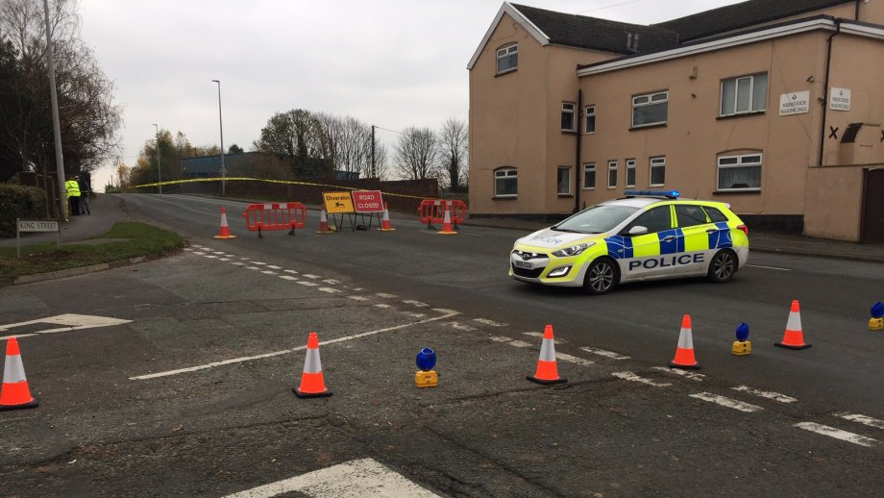
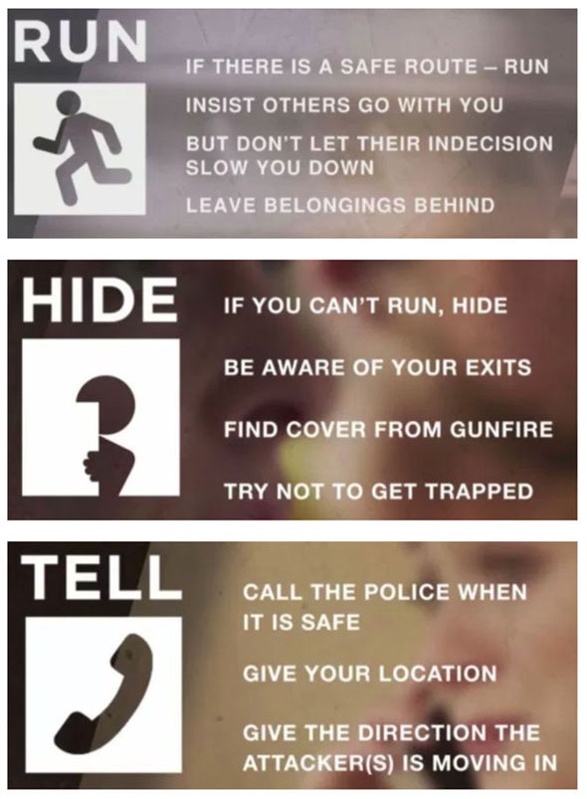
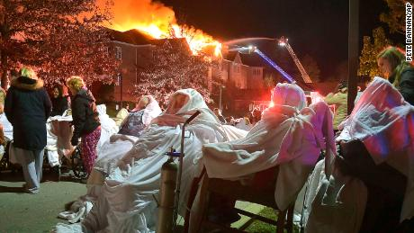
LO4: Responding to incidents and emergencies in a health, social care and child care environment.

Slide 22
Incidents and emergencies:
There are many types of accidents, incidents and emergencies that occur in health, social care and childcare environments. (refer back to hazards in LO1)
Exposure to hazardous substances or chemicals – refer to COSHH – info on LO2 KO.
Some incidents require evacuation of a premises.
Other accidents causing injury – may require first aid treatment at the setting or an ambulance to take them for appropriate treatment in hospital.
First Aid provision should be available in all settings under the Health and Safety (First Aid) Regulations. First aid requirements for employers are to;
Carry out risk assessments to identify the level of first aid provision required.
Provide appropriate first aid equipment and facilities.
Train and appoint staff to give first aid – if employees fall ill or get injured at work.
Have an effective method to record accidents or incidents that require first aid intervention.
Provide and adequate number of first aiders for the number of individuals in the setting.
Reporting of accidents and incidents:
It is a legal requirement for certain injuries, accidents and diseases to be recorded and reported to the HSE under RIDDOR regulations. (refer back to LO2 KO)
It is good practice to record all accidents this can inform future risk assessments in order to improve future safety standards.
For other incidents, like aggressive or drunken encounters, the police will need to be informed or, for a safeguarding issue, social services may need to be notified.
Floods, loss of water supply need to be reported to the water board. In case of a leak, a plumber would be called.
Any situation when the setting may need to be closed – families, parents or other contacts of the service users would need to be informed.
Evacuation procedures:(For fire procedures refer to info in LO2).
Other incidents that are similar and follow the same evaluation procedures as fire include;
Gas leak.
Flood.
Bomb threat.
All of the above require the setting to be evacuated swiftly and efficiently to keep people safe.
In the rare event of a firearms or weapon attack, the government has provided advice on how individuals can keep themselves safe. Information can be found in leaflets, posters and YouTube videos.
Run – if you can.
Hide – if you can’t run away, and
Tell – the police when it is safe to do so.
Care settings are encouraged to ensure they raise awareness of this advice sensitively, particularly with children.
Aggressive & dangerous encounters and unauthorized access.
Aggressive and dangerous encounters and unauthorized access could be due to individuals being under the influence of alcohol or drugs, or having mental health issues. They may be burglars or dissatisfied service users. The correct response needs to include;
Being calm.
Speaking clearly and firmly – asking them to leave.
Alerting other staff.
Keeping service users/residents/children away from incidents.
Calling the police – if they refuse to leave and persist.
Keeping yourself safe – do not put yourself at risk.

Slide 23
First Aider Responsibilities:
First aid is the initial treatment for a person who has had an accident or is suddenly taken ill. The purpose of a first can be summarized as the ‘Three P’s’.
Preserve life.
Prevent further injury.
Promote recovery.
4. Maintain respect and dignity:
Send spectators’ away.
Cover body parts to maintain dignity.
5. Get help:
Request the appropriate level of help. For example call 999 if a medical emergency, or call a doctor, parents or relatives.
6. Stay with the individual:
Use a calm and confident voice.
Don’t speak too quickly.
Say help is on the way.
Make eye contact.
Get down to their level.
A written record of the incident should be made so relatives can be informed of what has happened. Records also provide relevant facts that can inform investigations of incidents that may take place later on.
How are the ‘Three P’s’ carried out?
First aiders have six responsibilities – which address the ‘Three P’s’
1. Assess for danger:
Look around – check the areas around the casualty for any risks or possible dangers. For example; moving traffic nearby, boiling water, electrical current, chemicals, broken glass, fire etc.
2. Keeping yourself and the area safe:
Quickly remove any hazards, without putting yourself in danger. For example – moving a sharp knife or fallen char , switching off a cooker or socket. In a car accident making sure the ignition is off to reduce the risk of a spark causing a fire.
3. Prevent further harm:
Key signs to check are;
Are they conscious?
Is their airway open?
Do they have a pulse?
Administer appropriate emergency aid for the injury. For example – immersing the burned area in cold water, cleaning and dressing a graze, placing an unconscious person in the recovery position if safe to do so. Only attempt what you know can be done safely.
Exam Tips:
If asked to identify an appropriate action and explain the reasons for taking it, you must make sure that you give only one action. If you list several actions and you will not achieve full marks on the question – because the instruction is one action and explanation – read the questions carefully!
Make sure you know all six of the first aider responsibilities and you are able to give examples of actions for each one.

